Slide 1
10
Wireless, Mobile Computing, and Mobile Commerce

Slide 2
Wireless Technologies
Wireless Computer Networks and Internet Access
Mobile Computing and Mobile Commerce
Pervasive Computing
Wireless Security

Slide 3
Identify advantages and disadvantages of each of the four main types of wireless transmission media.
Explain how businesses can use short-range, medium-range, and long-range wireless networks, respectively.
Provide a specific example of how each of the five major m-commerce applications can benefit a business.

Slide 4
Describe technologies that underlie pervasive computing, providing examples of how businesses can utilize each one.
Explain how the four major threats to wireless networks can damage a business.

Slide 5
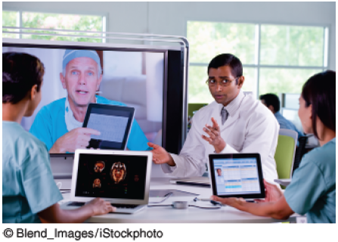
Mobile Commerce via Telemedicine at the Miami Children’s Hospital
Describe the advantages and the disadvantages of the iPad mobile app for patients. Do the same thing for medical carts and medical kiosks.
Describe the advantages and the disadvantages of the iPad mobile app for Miami Children’s Hospital. Do the same thing for medical carts and medical kiosks.

Slide 6
10.1
Wireless Technologies
Wireless Devices
Dematerialization
Wireless Transmission Media
Notes:
Wireless: without wires.
Mobile: something that changes its location over time.
Mobile Computing: a real-time, wireless connection between a mobile device and other computing environments, such as the Internet or an intranet.
Mobile Commerce (or M-Commerce): e-commerce (EC) transactions conducted with a mobile device.
Pervasive Computing (or Ubiquitous Computing): virtually every object has processing power with either wireless or wired connections to a global network.
Dematerialization: a phenomenon that occurs when the functions of many physical devices are included in one other physical device. Consider that your smartphone includes the functions of digital cameras for images and video, radios, televisions, Internet access via Web browsers, recording studios, editing suites, movie theaters, GPS navigators, word processors, spreadsheets, stereos, flashlights, board games, card games, video games, an entire range of medical devices, maps, atlases, encyclopedias, dictionaries, translators, textbooks, watches, alarm clocks, books, calculators, address books, credit card swipers, magnifying glasses, money and credit cards, car keys, hotel keys, cellular telephony, Wi-Fi, e-mail access, text messaging, a full QWERTY keyboard, and many, many others.

Slide 7
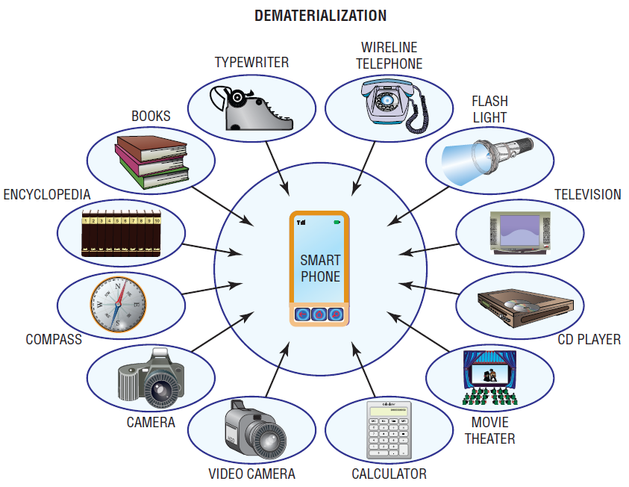
Figure 10.1: Dematerialization with Smartphones

Slide 8
Wireless Devices
Wireless Devices Provide Three Major Advantages:
Small enough to easily carry or wear
Sufficient computing power to perform productive tasks.
Can communicate wirelessly with the Internet and other devices.
Notes:
Wireless Devices Provide Three Major Advantages:
1. Small enough to easily carry or wear
2. Sufficient computing power to perform productive tasks.
3. Can communicate wirelessly with the Internet and other devices.
Wireless: without wires.
Mobile: something that changes its location over time.
Mobile Computing: a real-time, wireless connection between a mobile device and other computing environments, such as the Internet or an intranet.
Mobile Commerce (or M-Commerce): e-commerce (EC) transactions conducted with a mobile device.
Pervasive Computing (or Ubiquitous Computing): virtually every object has processing power with either wireless or wired connections to a global network.
Dematerialization: a phenomenon that occurs when the functions of many physical devices are included in one other physical device. Consider that your smartphone includes the functions of digital cameras for images and video, radios, televisions, Internet access via Web browsers, recording studios, editing suites, movie theaters, GPS navigators, word processors, spreadsheets, stereos, flashlights, board games, card games, video games, an entire range of medical devices, maps, atlases, encyclopedias, dictionaries, translators, textbooks, watches, alarm clocks, books, calculators, address books, credit card swipers, magnifying glasses, money and credit cards, car keys, hotel keys, cellular telephony, Wi-Fi, e-mail access, text messaging, a full QWERTY keyboard, and many, many others.

Slide 9
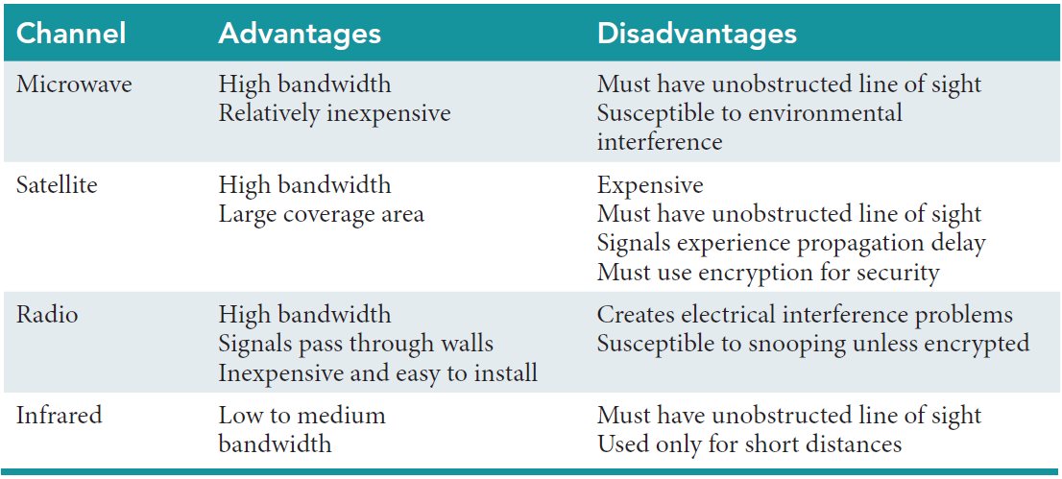
Table 10.1 Advantages & Disadvantages of Wireless Media

Slide 10
Wireless Transmission Media: Microwave
Advantages of Microware
High bandwidth
Relatively inexpensive
Disadvantages of Microwave
Must have unobstructed line of sight
Susceptible to environmental
interference

Slide 11
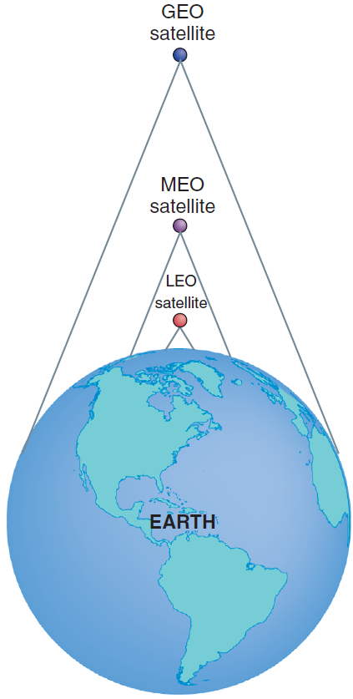
Wireless Transmission Media: Satellite
Advantages of Satellite
High bandwidth
Large coverage area
Disadvantages of Satellite
Expensive
Must have unobstructed line of sight
Signals experience propagation delay
Must use encryption for security

Slide 12
Satellites
Three Types of Satellites Circling Earth
Geostationary-Earth-Orbit (GEO)
Medium-Earth-Orbit (MEO)
Low-Earth-Orbit (LEO)
Footprint
Propagation Delay
Internet over Satellite (IoS)
Notes:
Footprint: the area of Earth’s surface reached by a satellite’s transmission overcomes the limitations of microwave data relay stations. The higher a satellite orbits, the larger its footprint.
Propagation Delay: One major limitation of GEO satellites is that their transmissions take a quarter of a second to send and return from the earth's surface.
Internet Over Satellite (IoS): in remote parts of the world it is the only option available for Internet connections because installing cables is either too expensive or physically impossible.

Slide 13
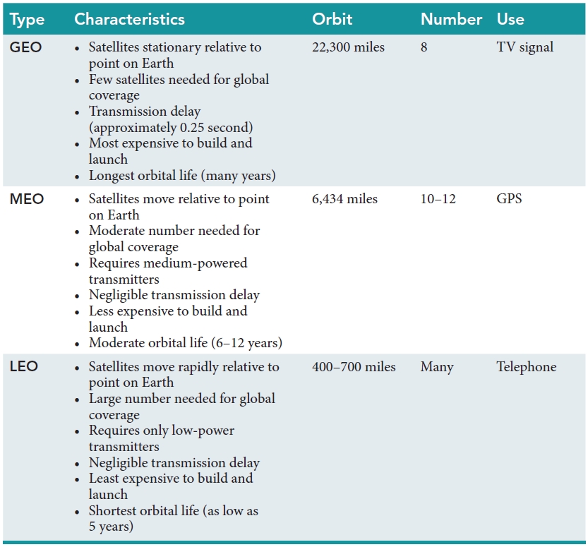
Table 10.2: Three Basic Types of Telecommunications Satellites

Slide 14
Satellites: Geostationary-Earth-Orbit (GEO)
22,300 miles above earth
Stationary relative to a point on Earth
Transmission delay (.25 seconds)
Longest orbital life (many years)
Few Needed for Global Coverage
Used for Television Signals
Most Expensive to Build and Launch
Notes:
Footprint: the area of Earth’s surface reached by a satellite’s transmission overcomes the limitations of microwave data relay stations. The higher a satellite orbits, the larger its footprint.
Propagation Delay: One major limitation of GEO satellites is that their transmissions take a quarter of a second to send and return from the earth's surface.
Footprint: the area of Earth’s surface reached by a satellite’s transmission overcomes the limitations of microwave data relay stations. The higher a satellite orbits, the larger its footprint.
Propagation Delay: One major limitation of GEO satellites is that their transmissions take a quarter of a second to send and return from the earth's surface.
Global Positioning System: a wireless system that utilizes satellites to enable users to determine their position anywhere on Earth. GPS is supported by 24 MEO satellites that are shared worldwide.
Satellite Radio (or digital radio): offers uninterrupted, near CD-quality transmission that is beamed to your radio, either at home or in your car, from both GEO (XM Radio) and MEO (Sirius) satellites in space.

Slide 15
Satellites: Medium-Earth-Orbit (MEO)
6,434 miles above earth
Satellites moves relative to a point on Earth
Negligible transmission delay
Moderate orbital life (6-12 years)
Moderate number needed for global coverage
Used for Global Positioning Systems
Less Expensive to Build and Launch
Notes:
Footprint: the area of Earth’s surface reached by a satellite’s transmission overcomes the limitations of microwave data relay stations. The higher a satellite orbits, the larger its footprint.
Propagation Delay: One major limitation of GEO satellites is that their transmissions take a quarter of a second to send and return from the earth's surface.
Global Positioning System: a wireless system that utilizes satellites to enable users to determine their position anywhere on Earth. GPS is supported by 24 MEO satellites that are shared worldwide.
Satellite Radio (or digital radio): offers uninterrupted, near CD-quality transmission that is beamed to your radio, either at home or in your car, from both GEO (XM Radio) and MEO (Sirius) satellites in space.

Slide 16
Satellites: Low-Earth-Orbit (LEO)
400-700 miles above earth
Move rapidly in relation to a point on Earth
Negligible transmission delay
Shortest orbital life (low as 5 years)
Large Number Needed for Global Coverage
Least Expensive to Build and Launch
Notes:
Footprint: the area of Earth’s surface reached by a satellite’s transmission overcomes the limitations of microwave data relay stations. The higher a satellite orbits, the larger its footprint.
Propagation Delay: One major limitation of GEO satellites is that their transmissions take a quarter of a second to send and return from the earth's surface.

Slide 17
’S ABOUT BUSINESS 10.1
Skybox Imaging Provides Commercial Images from Earth’s Orbit
Describe other applications of Skybox Imaging (not mentioned in the case).
Why might the U.S. government object to Skybox Imaging’s business? Provide specific examples in your answer.
Might other nations object to Skybox Imaging’s business? If so, which ones, and why?

Slide 18
Wireless Transmission Media: Radio
Advantages of Radio
High bandwidth
Signals pass through walls
Inexpensive and easy to install
Disadvantages of Radio
Creates electrical interference problems
Susceptible to snooping unless encrypted
Notes:
Radio: uses radio-wave frequencies to send data directly between transmitters and receivers.

Slide 19
Wireless Transmission Media: Infrared
Advantages of Infrared
Low to medium bandwidth
Disadvantages of Infrared
Must have unobstructed line of sight
Used only for short distances
Notes:
Infrared: is red light that is not commonly visible to human eyes and common applications of infrared light are found in remote control units for televisions and DVD and CD players.

Slide 20
10.2
Wireless Computer Networks and Internet Access
Short-Range Wireless Networks
Medium-Range Wireless Networks
Wide-Area Wireless Networks
Notes:
Short-Range Wireless Networks: have a range of 100 feet or less (e.g., Bluetooth, ultra-wideband (UWB), and near-field communications (NFC)).
Medium-Range Wireless Networks: the familiar wireless local area networks (WLANs) and the most common type of Medium-Range network is wireless fidelity (Wi-Fi).
Wide-Area Wireless Networks: networks that connect users to the Internet over a geographically dispersed territory, they typically operate over the licensed spectrum (government regulation).that is, they use portions of the wireless spectrum that are regulated by the government.

Slide 21
Short-Range Wireless Networks
Bluetooth
Bluetooth 1.0
Bluetooth 4.0
Personal Area Network
Ultra-Wideband
Near-Field Communications
Notes:
Short-Range Wireless Networks: have a range of 100 feet or less (e.g., Bluetooth, ultra-wideband (UWB), and near-field communications (NFC)).
Bluetooth: an industry specification used to create small personal area networks.
Bluetooth 1.0: can link up to eight devices within a 10-meter area (about 30 feet) with a bandwidth of 700 kilobits per second (Kbps) using low-power, radio-based communication.
Bluetooth 4.0: can transmit up to approximately 25 megabits per second (Mbps) up to 100 meters (roughly 300 feet).
Personal Area Network: a computer network used for communication among computer devices (e.g., telephones, personal digital assistants, and smartphones) located close to one person.
Ultra-Wideband: a high-bandwidth wireless technology with transmission speeds in excess of 100 Mbps which makes UWB a good choice for applications such as streaming multimedia from a personal computer to a television.
Near-Field Communications: has the smallest range of any short-range wireless networks, and is designed to be embedded in mobile devices such as cell phones and credit cards.

Slide 22
Medium-Range Wireless Networks
Wireless Fidelity (Wi-Fi)
Wireless Mesh Networks
Notes:
Medium-Range Wireless Networks: the familiar wireless local area networks (WLANs) and the most common type of Medium-Range network is wireless fidelity (Wi-Fi).
Wireless Fidelity (Wi-Fi): a medium-range WLAN.
Wireless Mesh Networks: networks using multiple Wi-Fi access points to create a wide area network that can be quite large and are essentially a series of interconnected local area networks.

Slide 23
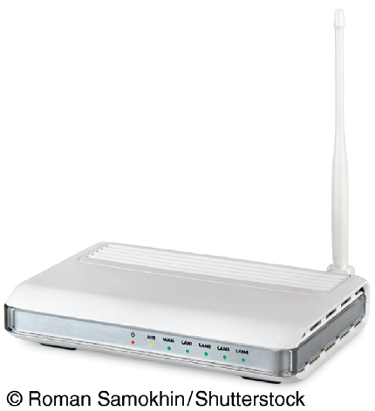
Wireless Fidelity (Wi-Fi)
Wireless Access Point
Hotspot
IEEE Wi-Fi Standards
Major Benefits of Wi-Fi
Wi-Fi Direct
MiFi
Super Wi-Fi
Wireless Mesh Networks
Notes:
Wireless Fidelity (Wi-Fi): a medium-range WLAN.
Wireless Access Point: a Wi-Fi medium range WLAN and a typical configuration includes a tranmitter with an antenna.
Hotspot: a wireless access point that provides service to a number of users within a small geographical perimeter (up to approximately 300 feet).
Wi-Fi Direct: enables peer-to-peer communications, so devices can connect directly allowing users to transfer content among devices without having to rely on a wireless antenna. It can connect pairs or groups of devices at Wi-Fi speeds of up to 250 Mbps and at distances of up to 800 feet.
MiFi: a small, portable wireless device that provides users with a permanent Wi-Fi hotspot wherever they go with a range of about 10 meters (roughly 30 feet).
Super Wi-Fi: a wireless network proposal that creates long-distance wireless Internet connections which uses the lower-frequency “white spaces” between broadcast TV channels which enable the signal to travel further and penetrate walls better than normal Wi-Fi frequencies.
Wireless Mesh Networks: networks using multiple Wi-Fi access points to create a wide area network that can be quite large and are essentially a series of interconnected local area networks.

Slide 24
IEEE Wi-Fi Standards
Institute of Electrical and Electronics Engineers (IEEE) WiFI Standards
802.11a
802.11b
802.11g
802.11n
802.11ac
802.11 ad
Notes:
Institute of Electrical and Electronics Engineers (IEEE) WiFI Standards
802.11a: supports wireless bandwidth up to 54 Mbps; high cost; short range; difficulty penetrating walls.
802.11b: supports wireless bandwidth up to 11 Mbps; low cost; longer range.
802.11g: supports wireless bandwidth up to 54 Mbps; high cost; longer range.
802.11n: supports wireless bandwidth exceeding 600 Mbps; higher cost than 802.11g; longer range than 802.11g.
802.11ac: will support wireless bandwidth of 1.3 Gbps (1.3 billion bits per second); will provide the ability to fully support a “multimedia home” in which high-definition video can be streamed simultaneously to multiple devices. Essentially, you will be able to wirelessly network your TV, DVR, smartphone, and sound system for complete ondemand access through any Internet-enabled device.
802.11 ad: supports wireless bandwidth up to 7 Gbps; targeted to the “wireless office” as opposed to the “wireless home.”

Slide 25
Major Benefits of Wi-Fi
Low cost
Ability to provide simple Internet access

Slide 26
Three Factors Preventing Commercial Wi-Fi Market from Expanding:
Roaming
Security
Cost
Notes:
Three factors are prevent the commercial Wi-Fi market from expanding:
Roaming: At this time, users cannot roam from hotspot to hotspot if the hotspots use different Wi-Fi network services. Unless the service is free, users have to log on to separate accounts.
Security: the second barrier to greater acceptance of Wi-Fi because Wi-Fi uses radio waves, it is difficult to shield from intruders.
Cost: even though Wi-Fi services are relatively inexpensive, many experts question whether commercial Wi-Fi services can survive when so many free hotspots are available to users.

Slide 27
’S ABOUT BUSINESS 10.2
A Wi-Fi Network Provides Communications at the 2014 Winter Olympic Games
Describe why wireless communications were critical to the success of the 2014 Winter Olympic Games. Provide specific examples to support your answer.
What other potential problems did Avaya have to consider that were not mentioned in this case? Provide specific examples to support your answer.

Slide 28
Wide-Area Wireless Networks
Cellular Radio
Generations of Cellular Technology Evolution
Wireless Broadband or WiMAX
Notes:
Wide-Area Wireless Networks: networks that connect users to the Internet over a geographically dispersed territory, they typically operate over the licensed spectrum (government regulation).that is, they use portions of the wireless spectrum that are regulated by the government.
Cellular Radio: Cellular telephones (cell phones) provide two-way radio communications over a cellular network of base stations with seamless handoffs.
Wireless Broadband or WiMAX: Worldwide Interoperability for Microwave Access, popularly known as WiMAX, is the name for IEEE Standard 802.16 which has a wireless access range of up to 31 miles and a data transfer rate of up to 75 Mbps. It is a secure system, and it offers features such as voice and video.

Slide 29
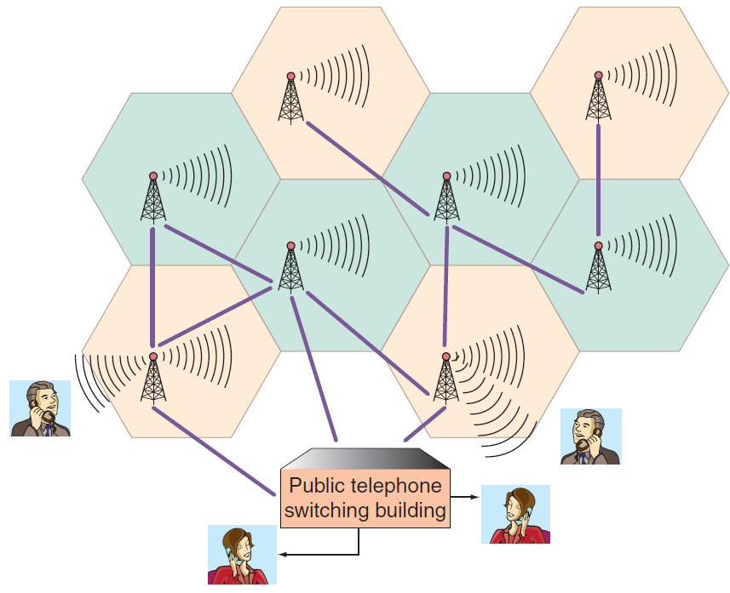
Figure 10.5: Smart Phone & GPS system
Notes:
Cellular Radio: Cellular telephones (cell phones) provide two-way radio communications over a cellular network of base stations with seamless handoffs.

Slide 30
Generations of Cellular Technology Evolution
(1G) First generation
(2G) Second generation
2.5G
(3G) Third generation
(4G) Fourth generation
(5G) Fifth generation
Notes:
Generations of Cellular Technology Evolution:
First generation (1G): cellular networks used analog signals and had low bandwidth (capacity).
Second generation (2G): uses digital signals primarily for voice communication; it provides data communication up to 10 Kbps.
2.5G: uses digital signals and provides voice and data communication up to 144 Kbps.
Third generation (3G): uses digital signals and can transmit voice and data up to 384 Kbps when the device is moving at a walking pace, 128 Kbps when it is moving in a car, and up to 2 Mbps when it is in a fixed location. It supports video, Web browsing, and instant messaging.
Fourth generation (4G): is not one defined technology or standard. The International Telecommunications Union (ITU) has specified speed requirements for 4G: 100 Mbps (million bits per second) for high-mobility communications such as cars and trains, and 1 Gbps (billion bits per second) for low-mobility communications such as pedestrians. A 4G system is expected to provide a secure all-IP-based mobile broadband system to all types of mobile devices.
Fifth Generation (5G): expected to be deployed by 2020, 5G networks are predicted to be faster and more intelligent than previous generations of cellular networks. With 5G, wearable computers (e.g., Fitbit), smartphones, tablets, and other devices with sensors that are location- and context-aware will work together with apps and services that you use.

Slide 31
Wireless Broadband or WiMAX
Worldwide Interoperability for Microwave Access (WiMAX)
WiMAX = IEEE Standard 802.16
Wireless access range of up to 31 miles
Data transfer rate of up to 75 Mbps
A secure system offering voice and video
Notes:
Wireless Broadband or WiMAX: Worldwide Interoperability for Microwave Access (WiMAX) is the name for IEEE Standard 802.16 which has a wireless access range of up to 31 miles and a data transfer rate of up to 75 Mbps. It is a secure system, and it offers features such as voice and video.

Slide 32
’S ABOUT BUSINESS 10.3
A Tiny Cellular Network for a Remote Tribe in Indonesia
Describe several advantages of the network for the villagers.
Describe several advantages of the network for the Indonesian government.

Slide 33
Wireless and Mobile
What the GSM3GHSDPA14GLTE???

Slide 34
10.3
Mobile Computing and Mobile Commerce
Mobile Computing, Mobility, and Broad Reach
Mobile Commerce
Mobile Commerce Applications
Notes:
Mobile Computing: a real-time connection between a mobile device and other computing environments, such as the Internet or an intranet.
Mobility: means that users carry a device with them and can initiate a real-time contact with other systems from wherever they happen to be.
Broad Reach: when users carry an open mobile device, they can be reached instantly, even across great distances.
Mobility and Broad Reach Create Five Value-added Attributes that Break the Barriers of Geography and Time:
Ubiquity
Convenience
Instant connectivity
Personalization
Localization of products and services

Slide 35
Mobility and Broad Reach
Mobility and Broad Reach Create Five Value-added Attributes:
Ubiquity
Convenience
Instant connectivity
Personalization
Localization of products and services
Notes:
Mobile Computing: a real-time connection between a mobile device and other computing environments, such as the Internet or an intranet.
Mobility: means that users carry a device with them and can initiate a real-time contact with other systems from wherever they happen to be.
Broad Reach: when users carry an open mobile device, they can be reached instantly, even across great distances.
Mobility and Broad Reach Create Five Value-added Attributes that Break the Barriers of Geography and Time:
Ubiquity
Convenience
Instant connectivity
Personalization
Localization of products and services

Slide 36
Mobile Commerce
Development of M-Commerce is Driven by:
Widespread availability of mobile devices
Declining prices
Bandwidth improvement
Notes:
Mobile Commerce: electronic commerce (EC) transactions that are conducted in a wireless environment, especially via the Internet.
Development of M-Commerce is Driven by:
Widespread availability of mobile devices: By mid-2014, some 6 billion cell phones were in use throughout the world. Cell phones are spreading more quickly in the developing world than the developed world. Experts estimate that within a few years about 70 percent of cell phones in developed countries will have Internet access. Mobile Internet access in developing countries will increase rapidly as well.
Declining prices: The price of wireless devices is declining and will continue to decline.
Bandwidth improvement: To properly conduct m-commerce, you need sufficient bandwidth for transmitting text, voice, video, and multimedia. Wi-Fi, 4G cellular technology, and WiMAX all provide the necessary bandwidth.

Slide 37
Mobile Commerce Applications
Location-Based Applications and Services
Financial Services
Intrabusiness Applications
Accessing Information
Telemetry Applications

Slide 38
Location-Based Applications and Services
Location-Based Commerce (L-Commerce)
Benefits of Location-Based Services for Users
Benefits of Location-Based Services for Service Providers
Notes:
Location-Based Applications and Services: M-commerce B2C applications include location-based services and location-based applications.
Location-Based Commerce (L-Commerce): Location-based mobile commerce.

Slide 39
Benefits of Location-Based Services for Users:
Request the nearest business or service
Receive alerts
Find a friend
Locating taxis, service personnel, doctors, and rental equipment
Notes:
Location-Based Services Allow User to:
Request the nearest business or service, such as an ATM or a restaurant
Receive alerts, such as a warning of a traffic jam or an accident
Find a friend
Locating taxis, service personnel, doctors, and rental equipment

Slide 40
Benefits of Location-Based Services for Service Providers
Schedule fleets
Tracking objects such as packages and train boxcars
Find information such as navigation, weather, traffic, and room schedules
Targeting advertising
Automating airport check-ins
Notes:
Location-Based Services Allow Service Providers to:
schedule fleets
tracking objects such as packages and train boxcars
find information such as navigation, weather, traffic, and room schedules
targeting advertising
automating airport check-ins

Slide 41
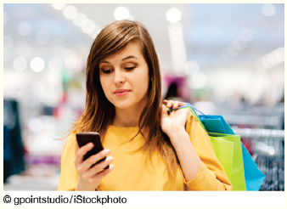
’S ABOUT BUSINESS 10.4
Apple’s iBeacons
What other uses for iBeacon can you think of?
Other than privacy concerns, what are other possible disadvantages of the iBeacon app? Provide specific examples to support your answer.

Slide 42
Mobile Commerce Applications: Financial Services
Banking
Micropayments
Money Transfers
Wireless Mobile Wallets (M-Wallets)
Bill Payment Services
Notes:
Financial Services: Mobile financial applications including banking, wireless payments and micropayments, money transfers, wireless wallets, and bill payment services.
Micropayment: very small purchase amounts (generally less than $10) are called micropayments.
Wireless Mobile Wallets (m-wallets): enable cardholders to make purchases with a single click from their mobile devices.

Slide 43
Intrabusiness Applications
Mobile Computing For Employee Support:
Workflow Applications
Dispatch Functions
Notes:
Intrabusiness Applications: Although business-to-consumer (B2C) m-commerce receives considerable publicity, most of today’s m-commerce applications actually are used within organizations.
Mobile Computing For Employee Support:
Workflow Applications
Dispatch Functions

Slide 44
Target Areas for Mobile Delivery and Dispatch Services:
Employee job assignment
Transportation
Utilities
Field service
Healthcare
Security
Notes:
Target Areas for Mobile Delivery and Dispatch Services:
Employee job assignment
Transportation (delivery of food, oil, newspapers, cargo; courier services; tow trucks; taxis)
Utilities (gas, electricity, phone, water)
Field service (computers, office equipment, home repair)
Healthcare (visiting nurses, doctors, social services)
Security (patrols, alarm installation)

Slide 45
Accessing Information
Mobile Portals
Voice Portals
Notes:
Mobile Portal: portals that aggregates and provides content and services for mobile users.
Voice Portal: a Web site with an audio interface.

Slide 46
Mobile Computing Applications: Telemetry
Identify maintenance problems in equipment
Monitor medical patients
Control medical equipment remotely
Remote vehicle diagnosis & preventive maintenance
Find My iPhone
Notes:
Telemetry Applications: the wireless transmission and receipt of data gathered from remote sensors.
Mobile Computing Applications: Telemetry
Identify maintenance problems in equipment
Monitor medical patients
Control medical equipment remotely
Remote vehicle diagnosis & preventive maintenance
Find My iPhone

Slide 47
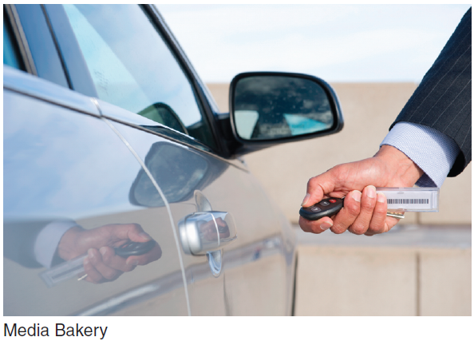
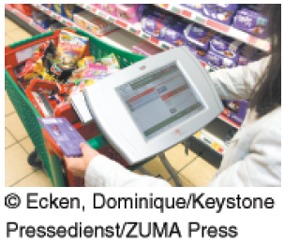
10.4
Pervasive Computing
Radio-Frequency Identification (RFID)
Wireless Sensor
Networks
The Internet of Things
Notes:
Radio-Frequency Identification (RFID): technology that allows manufacturers to attach tags with antennas and computer chips on goods and then track their movement through radio signals. RFID was developed to replace bar codes.
Wireless Sensor Networks (WSNs): networks of interconnected, battery powered, wireless sensors called motes that are placed into the physical environment.
Internet of Things (IoT): a scenario in which objects, animals, and people are provided with unique identifiers and the ability to automatically transfer data over a network without requiring human-to-human or human-to-computer interaction.

Slide 48
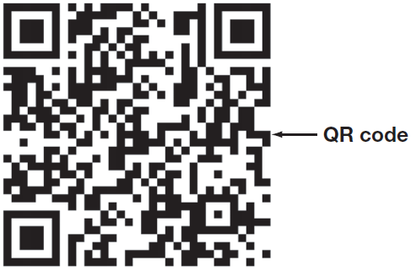
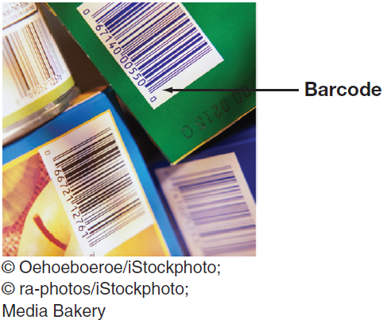
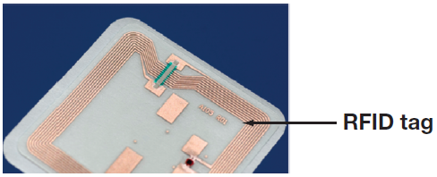
Radio-Frequency Identification (RFID)
RFID
Bar Codes
QR Codes
Notes:
Radio-Frequency Identification (RFID): technology that allows manufacturers to attach tags with antennas and computer chips on goods and then track their movement through radio signals. RFID was developed to replace bar codes.
Universal Product Code (UPC): A typical bar code made up of 12 digits that are batched in various groups. The first digit identifies the item type, the next five digits identify the manufacturer, and the next five identify the product. The last digit is a check digit for error detection.
RFID Systems: tags have embedded microchips, which contain data, and antennas to transmit radio signals over a short distance to RFID readers including information that uniquely identifies an item (location and when it was made).
QR code: a two-dimensional code, readable by dedicated QR readers and camera phones
Limitations of Bar codes:
Require a line of sight to the scanning device
Pose substantial problems in a manufacturing plant, warehouse or shipping/receiving dock
can be ripped, soiled, or lost
identifies the manufacturer and product but not the actual item
Two Basic Types of RFID Tags:
Active RFID: tags that use internal batteries for power, and they broadcast radio waves to a reader.
Passive RFID: tags rely entirely on readers for their power, less expensive than active tags, and can be read only up to 20 feet.

Slide 49
RFID
RFID Systems
Two Basic Types of RFID Tags
Active RFID Tags
Passive RFID Tags
Notes:
Radio-Frequency Identification (RFID): technology that allows manufacturers to attach tags with antennas and computer chips on goods and then track their movement through radio signals. RFID was developed to replace bar codes.
RFID Systems: tags have embedded microchips, which contain data, and antennas to transmit radio signals over a short distance to RFID readers including information that uniquely identifies an item (location and when it was made).
Two Basic Types of RFID Tags:
Active RFID: tags that use internal batteries for power, and they broadcast radio waves to a reader.
Passive RFID: tags rely entirely on readers for their power, less expensive than active tags, and can be read only up to 20 feet.

Slide 50
Bar Codes
Limitations of Bar Codes:
Requires line of sight from scanning device
Pose substantial problems in manufacturing plants, warehouses and shipping/receiving docks
Paper bar codes are easily damaged
Identifies the manufacturer and product but not the actual item
Notes:
Universal Product Code (UPC): A typical bar code made up of 12 digits that are batched in various groups. The first digit identifies the item type, the next five digits identify the manufacturer, and the next five identify the product. The last digit is a check digit for error detection.
Limitations of Bar codes:
Require a line of sight to the scanning device
Pose substantial problems in a manufacturing plant, warehouse or shipping/receiving dock
Paper bar codes can be ripped, soiled, or lost
identifies the manufacturer and product but not the actual item

Slide 51
QR Codes: Advantages Over Bar Codes
Store more information
Data types stored include numbers, text, URLs, and even Japanese characters.
Smaller because they store information both horizontally and vertically.
Read from any direction or angle
More resistant to damage
Notes:
QR code: a two-dimensional code, readable by dedicated QR readers and camera phones
Advantages of QR codes (over bar codes):
• QR codes can store much more information.
• Data types stored in QR codes include numbers, text, URLs, and even Japanese characters.
• QR codes are smaller because they store information both horizontally and vertically.
• QR codes can be read from any direction or angle, so they are less likely to be misread.
• QR codes are more resistant to damage.

Slide 52
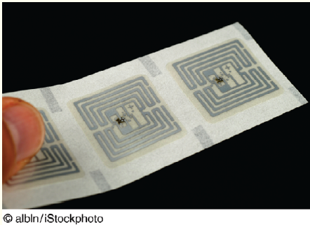
’S ABOUT BUSINESS 10.5
Marks & Spencer Embraces RFID
Describe how RFID technology can generate increased customer satisfaction.
What are potential disadvantages to implementing RFID technology in a retailer such as Marks & Spencer?
Why did Marks & Spencer initially deploy RFID technology on a limited basis? In your opinion, was this the correct strategy? Why or why not? Be specific.

Slide 53
Wireless Sensor Networks
Motes
Capability of Wireless Sensor Networks
Applications of Wireless Sensor Networks
Notes:
Wireless Sensor Networks (WSNs): networks of interconnected, battery powered, wireless sensors called motes that are placed into the physical environment.
Motes: wireless sensors that collect data from many points over an extended space. They contain processing, storage, and radio-frequency sensors and antennas. Each mote “wakes up” or activates for a fraction of a second when it has data to transmit. It then relays those data to its nearest neighbor. An advantage of a wireless sensor network is that if one mote fails, then another one can pick up the data.
Motes provide information that enables a central computer to integrate reports of the same activity from different angles within the network.
Mote networks can determine with much greater accuracy information such as the direction in which a person is moving, the weight of a vehicle, and the amount of rainfall over a field of crops.
Applications of Wireless Sensors:
Digital thermostats = energy efficiency
sensors in bridges and oil rigs = alerts of needed repairs
Sensors in jet engines = real time data on operating performance
Sensors in fruit & vegetable crates = warning in advance of spoilage
Improve a city’s use of water, electricity, and transportation
Smart/digital water meters = monitoring of water use and potential leaks
Smart electrical meters = smart grid monitoring electricity usage

Slide 54
Capability of Wireless Sensor Networks
If one mote fails the gap is covered by nearby motes
Provides data on activities from different angles
Determine direction of movement
Weight of a vehicle
Amount of rainfall over a field of crops
Notes:
Wireless Sensor Networks (WSNs): networks of interconnected, battery powered, wireless sensors called motes that are placed into the physical environment.
Motes: wireless sensors that collect data from many points over an extended space. They contain processing, storage, and radio-frequency sensors and antennas. Each mote “wakes up” or activates for a fraction of a second when it has data to transmit. It then relays those data to its nearest neighbor. An advantage of a wireless sensor network is that if one mote fails, then another one can pick up the data.
Motes provide information that enables a central computer to integrate reports of the same activity from different angles within the network.
Mote networks can determine with much greater accuracy information such as the direction in which a person is moving, the weight of a vehicle, and the amount of rainfall over a field of crops.

Slide 55
Applications of Wireless Sensor Networks
Digital thermostats for energy efficiency
Repair alerts on bridges and oil rigs
Real time operating performance reporting in jet engines
Warning of produce spoilage
Improve a city’s use of utilities
Smart/digital water meters
Smart electrical meters
Notes:
Applications of Wireless Sensors:
Digital thermostats = energy efficiency
sensors in bridges and oil rigs = alerts of needed repairs
Sensors in jet engines = real time data on operating performance
Sensors in fruit & vegetable crates = warning in advance of spoilage
Improve a city’s use of water, electricity, and transportation
Smart/digital water meters = monitoring of water use and potential leaks
Smart electrical meters = smart grid monitoring electricity usage

Slide 56
The Internet of Things (IoT)
Capabilities of IoT
Examples of IoT Use
Notes:
Internet of Things (IoT): a scenario in which objects, animals, and people are provided with unique identifiers and the ability to automatically transfer data over a network without requiring human-to-human or human-to-computer interaction.
Examples of IoT Use:
Coke machines
A heart monitor implant
A farm animal with a biochip transmitter
An automobile tire pressure
Capabilities of IoT:
Reducing waste, loss, and cost
Identifying the need for repair, replacement, or recall
Tracking expiration data on perishable items

Slide 57
Capabilities of IoT
Reducing waste, loss, and cost
Identifying the need for repair, replacement, or recall
Tracking expiration data on perishable items
Notes:
Internet of Things (IoT): a scenario in which objects, animals, and people are provided with unique identifiers and the ability to automatically transfer data over a network without requiring human-to-human or human-to-computer interaction.
Capabilities of IoT:
Reducing waste, loss, and cost
Identifying the need for repair, replacement, or recall
Tracking expiration data on perishable items

Slide 58
Examples of IoT Use
Coke machines
A heart monitor implant
A farm animal with a biochip transmitter
An automobile tire pressure
Notes:
Internet of Things (IoT): a scenario in which objects, animals, and people are provided with unique identifiers and the ability to automatically transfer data over a network without requiring human-to-human or human-to-computer interaction.
Examples of IoT Use:
Coke machines
A heart monitor implant
A farm animal with a biochip transmitter
An automobile tire pressure

Slide 59
10.5
Wireless Security
Four Major Threats to Wireless Networks
Rogue Access Point (Evil Twin)
War Driving
Eavesdropping
Radio Frequency Jamming
Notes:
Four Major Threats to Wireless Networks:
Rogue Access Point: an unauthorized access point connected to a wireless network.
Evil Twin Attack: the attacker is in the vicinity with a Wi-Fi-enabled computer and a separate connection to the Internet. Using a hotspotter—a device that detects wireless networks and provides information on them the attacker simulates a wireless access point with the same wireless network name, or SSID, as the one that authorized users expect. If the signal is strong enough, users will connect to the attacker’s system instead of the real access point.
War Driving: the act of locating WLANs while driving (or walking) around a city or elsewhere.
Eavesdropping: efforts by unauthorized users to access data that are traveling over wireless networks.
Radio-Frequency (RF) Jamming: a person or a device intentionally or unintentionally interferes with your wireless network transmissions.

